Slide 1
Chapter 2
Basic Prayer-walking

Slide 2
Simple to Learn
Most Christians learn how to prayer-walk quickly. Why? Once we get beyond habits of housing our prayers in stained-glass confinements, we experience a simple truth of prayer: Intercession need not be long-distance prayer. We instinctively draw near to those for whom we pray. Prayer-walking is as basic as caring for others and crying for help. It may actually be a more elementary format for prayer. It is easier to direct our hearts with genuine concern for what fills our eyesight.

Slide 3
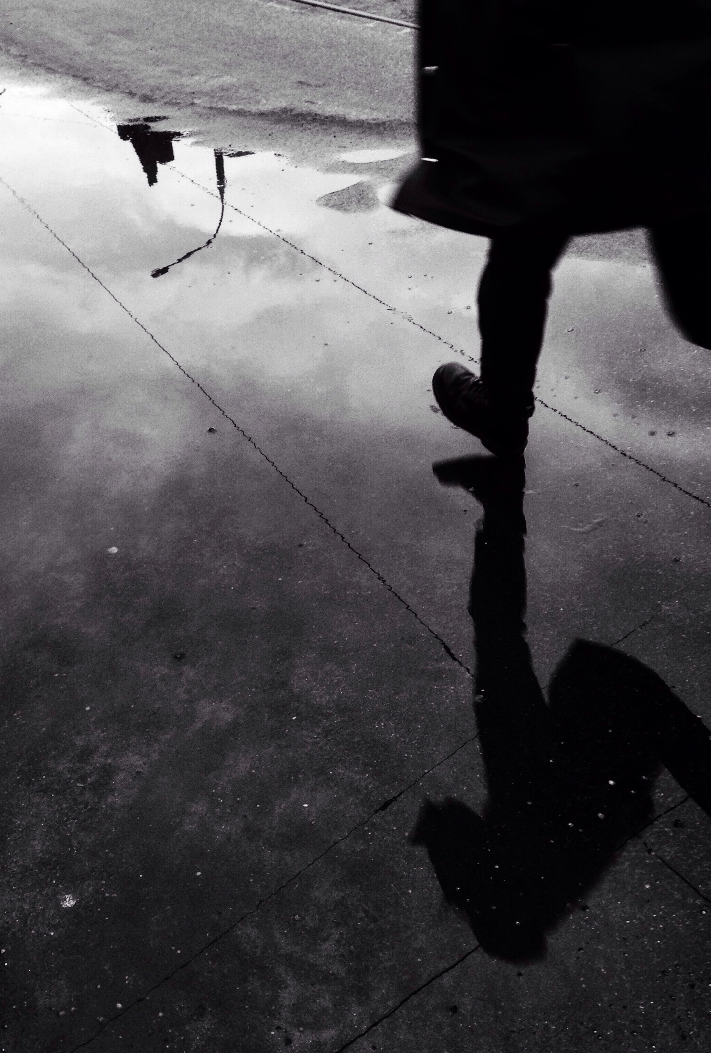
Hard to Pursue
Prayer-walking is spiritual battle – Prayer of any kind is a struggle. Every prayer seems contested in forceful ways.
Prayer-walking requires patience-Prayer-walking can be tough to continue because of our ingrained impatience. We want instant results.
Prayer-walkers need the freedom of well-learned fundamentals. – Much of the pleasure of prayer-walking is the joy of discovering hundreds of ways to pray for the same neighborhood. Its even more fun to be on the scene when God answers prayer in surprising ways.
Notes:
Prayer walking is a spiritual battle – Prayer of any kind is a struggle. Every prayer seems contested in forceful ways. When we step beyond the boundaries of our own homes, the struggle to pray escalates.
Prayer walking requires patience-Prayer walking can be tough to continue because of our ingrained impatience. We want instant results. There is a slow-burn significance to prayer walking. Generations of harm are being undone. Seeds of a new life are being planted, germinating beneath the surface of everyday life. Prayer walkers need to be patient because God is patient. He is unfolding, step by step, something glorious for his Son in every community.
Perhaps impatience has its roots in self-concern. Prayerwalking will always disappoint us as a device for merely making bad things go away.
But our hearts turn to God’s highest desire o our communities. Perseverance becomes more than possible. Well-done prayer walking can nurture an expectation of large measures of His kingdom.
Prayer walkers need the freedom of well-learned fundamentals. Much of the pleasure of prayer walking is the joy of discovering hundreds of ways to pray or the same neighborhood. It is even more fun to be on the scene when God answers prayer in surprising ways. The most persistent prayer walkers are the ones who seek always to grow in the basic foundations of praying according to the Word of God and with the Spirit of God

Slide 4
Before the Walk: Prepare
Refresh Yourself in God
Prepare Your Heart
Gather Your Mind
Seek God for Assistance
Refresh Relationships
Receive Each Other
Forgive Each Other
Approach God
Brief the Team
Who? Organize prayer teams
Where? Designate areas, routes, and sites.
When? Agree on timing
What? Review topics of prayer
Why? Emphasize the significance of prayer-walking
Notes:
Refresh Yourself in God – You are adequate for the task, provided you give your whole self-body, mind, heart and spirit. It makes sense to begin every prayer walk with a time of worship before God.
Prepare your heart – Open your mouth in order to open your heart. Praise.
Put the name of Jesus on your lips.
Dismiss other desires or affections.
Position your heart before God in fresh gratitude and blessing.
Gather your mind – Take charge of the directions your mind will go.
Fix your attention on the purposes, ways, and thoughts of God.
Reading Scripture audibly helps to focus your attention.
Leave pressures and other thoughts to God.
Seek God for Assistance – Be still before Him for a short while
Seek to sense special instructions from the Lord regarding where you should walk or what you should pray.
Go to the plans that you have formed unless you sense otherwise.
Don’t be trapped into thinking that every prayer walking session should be different
Refresh Relationships – Perhaps the strongest argument against prayer-walking by yourself is that you miss out on making the unassailable prophetic statement of believers literally walking together.
Love relationships become Christ’s “body language” to the heavenlies. You can imagine the havoc when there is estrangement and sinful friction between prayer0walkers. The foremost issue of spiritual battle is our love for one another.
Receive Each Other – Take the time to meet and greet each other as you gather
Forgive Each Other – Preferably, prayer walkers will have repaired relationships with each other before the appointed hour for prayer walking.
Rancorous relationships can open prayer walkers to significant vulnerability. Prayer walkers with refreshed relationships step out from high ground.
Approach God – Take your stance before the altar, enthroned in highest heaven. The way is opened for us forever by the blood and priestly excellence of Jesus.
Brief the Team – Brief them about the five basic parameters of the day’s prayer walk
Who? Organize prayer teams
Where? Designate areas, routes, and sites.
When? Agree on timing
What? Review topics of prayer
Why? Emphasize the significance of prayer-walking

Slide 5
During the Walk: Praying
Open Your Eyes
Open Your Ears`
Open Your Mouth
Pray Together
Pray with Scripture
Pray with Relevance
Pray with Reverence
Pray with Expectancy
Notes:
Open Your Eyes – Most of prayer walking is vision, which has been described as “the art of seeing what you are looking at.”
During the prayer walk, seeing a “For Sale” sign may stimulate you to pray for those who have moved away or to bless the family that will soon move in.
A practical way to use “the eyes of the heart” (Eph. 1:18) is to ask God to help you see the city with his eyes. He is well able to show you what you need to see.
Open your ears so that two-way prayer transpires. Listen for God’s whispered cues. Expect Him to highlight the truths you have hidden in your heart and apply them to what is around you.
Open Your Mouth – Enjoy Spirit-directed silence, but or the most part pray aloud. Faith is bolstered as you verbalize prayer.
Praying aloud doesn’t mean praying loudly. Though some occasions call for dramatic, outspoken praying, most prayer walking takes place in a quiet, unobtrusive way.
Don’t wait for impassioned feelings to float your prayers. Choose to begin voicing what needs to be prayed.
Prayer walks find themselves praying very deliberately most of the time.
Pray Together – Seek to consciously follow and reinforce prayers lifted by others in your prayer team. One prayer multiplies with another as you learn to agree in your requests.
Pursue a conversational style so that you can develop cogent themes and topics together. Sticking to the subject can prove challenging with so many prayer-provoking sights around you.
It’s usually best to press a few points of prayer as far as you can, rather than hoping your team will cover every need with every prayer walk.
Learn to enjoy praying through the most important matters again and again.
Pray with Scripture – Sometimes prayer walkers behold obvious needs but fail to sense how to pray.
Take along bits of Scripture or a small Bible when you walk.
With minimal adaptation, these prayers virtually pray themselves.
Praying the Word of God is praying the will of God
Pray with Relevance – Allow the community you are prayer walking to preoccupy your prayer.
Leave personal “Laundry lists” of prayer needs behind.
Pray with sensitivity to the people and places you are actually encountering.
Mix compassion with curiosity as you pass homes, shops, and schools.
Rouse your interest in familiar settings and faces by considering how their stories may unfold in soon coming years.
What have they experienced to bring them to this point? What does God desire for them?

Slide 6
After the Walk: Reporting
Assemble prayer-walkers soon after walking
Tell stories of answered prayers
Be ready for heavy hearted or exultant
Make a record for future walks
Evaluate Your prayer-walking session
Decide ongoing strategy
Notes:
Assemble prayer walkers soon after walking to report to each other significant prayers and insights.
Tell stories of answered prayers, but avoid creating an expectation that each prayer walker will have a dramatic story to tell.
Be ready for any who may return heavy-hearted or exultant.
Keep a record of important matters to help in future prayer walking.
Some prayer walkers maintain a journal to keep track of prayers prayed as memory can quickly fade.
Trace accomplished routes on a map.
Evaluate the prayer walking session How can you make changes that will enrich later prayer walks?
Consider what your prayers and insights may mean for various ministry efforts.
Has God spoken in such a way that a word should be wisely shared with others?
Decide how, when, and where to continue prayer walking.

