Slide 1
Chapter 3
Beyond Technique
Notes:
Why pray in proximity? What is really going on when people walk and pray?

Slide 2
God at Work Through Prayer
Prayer walking doesn’t “work” any more than any other form of prayer “works.” When people pray, it is God himself who works all things according to his will. The mysteries of why and how He involves His children with Him by their praying has never been fully comprehended. Though hard to grasp, It’s wonderfully true: God is at work with us when we pray.
Think of prayerwalking as a simple help to intercession. Prayerwalking helps intercession in three specific ways.
1) Prayer Walking helps us agree in prayer, 2) Prayer Walking helps focus your faith, 3) Prayer Walking helps guide your prayers.

Slide 3
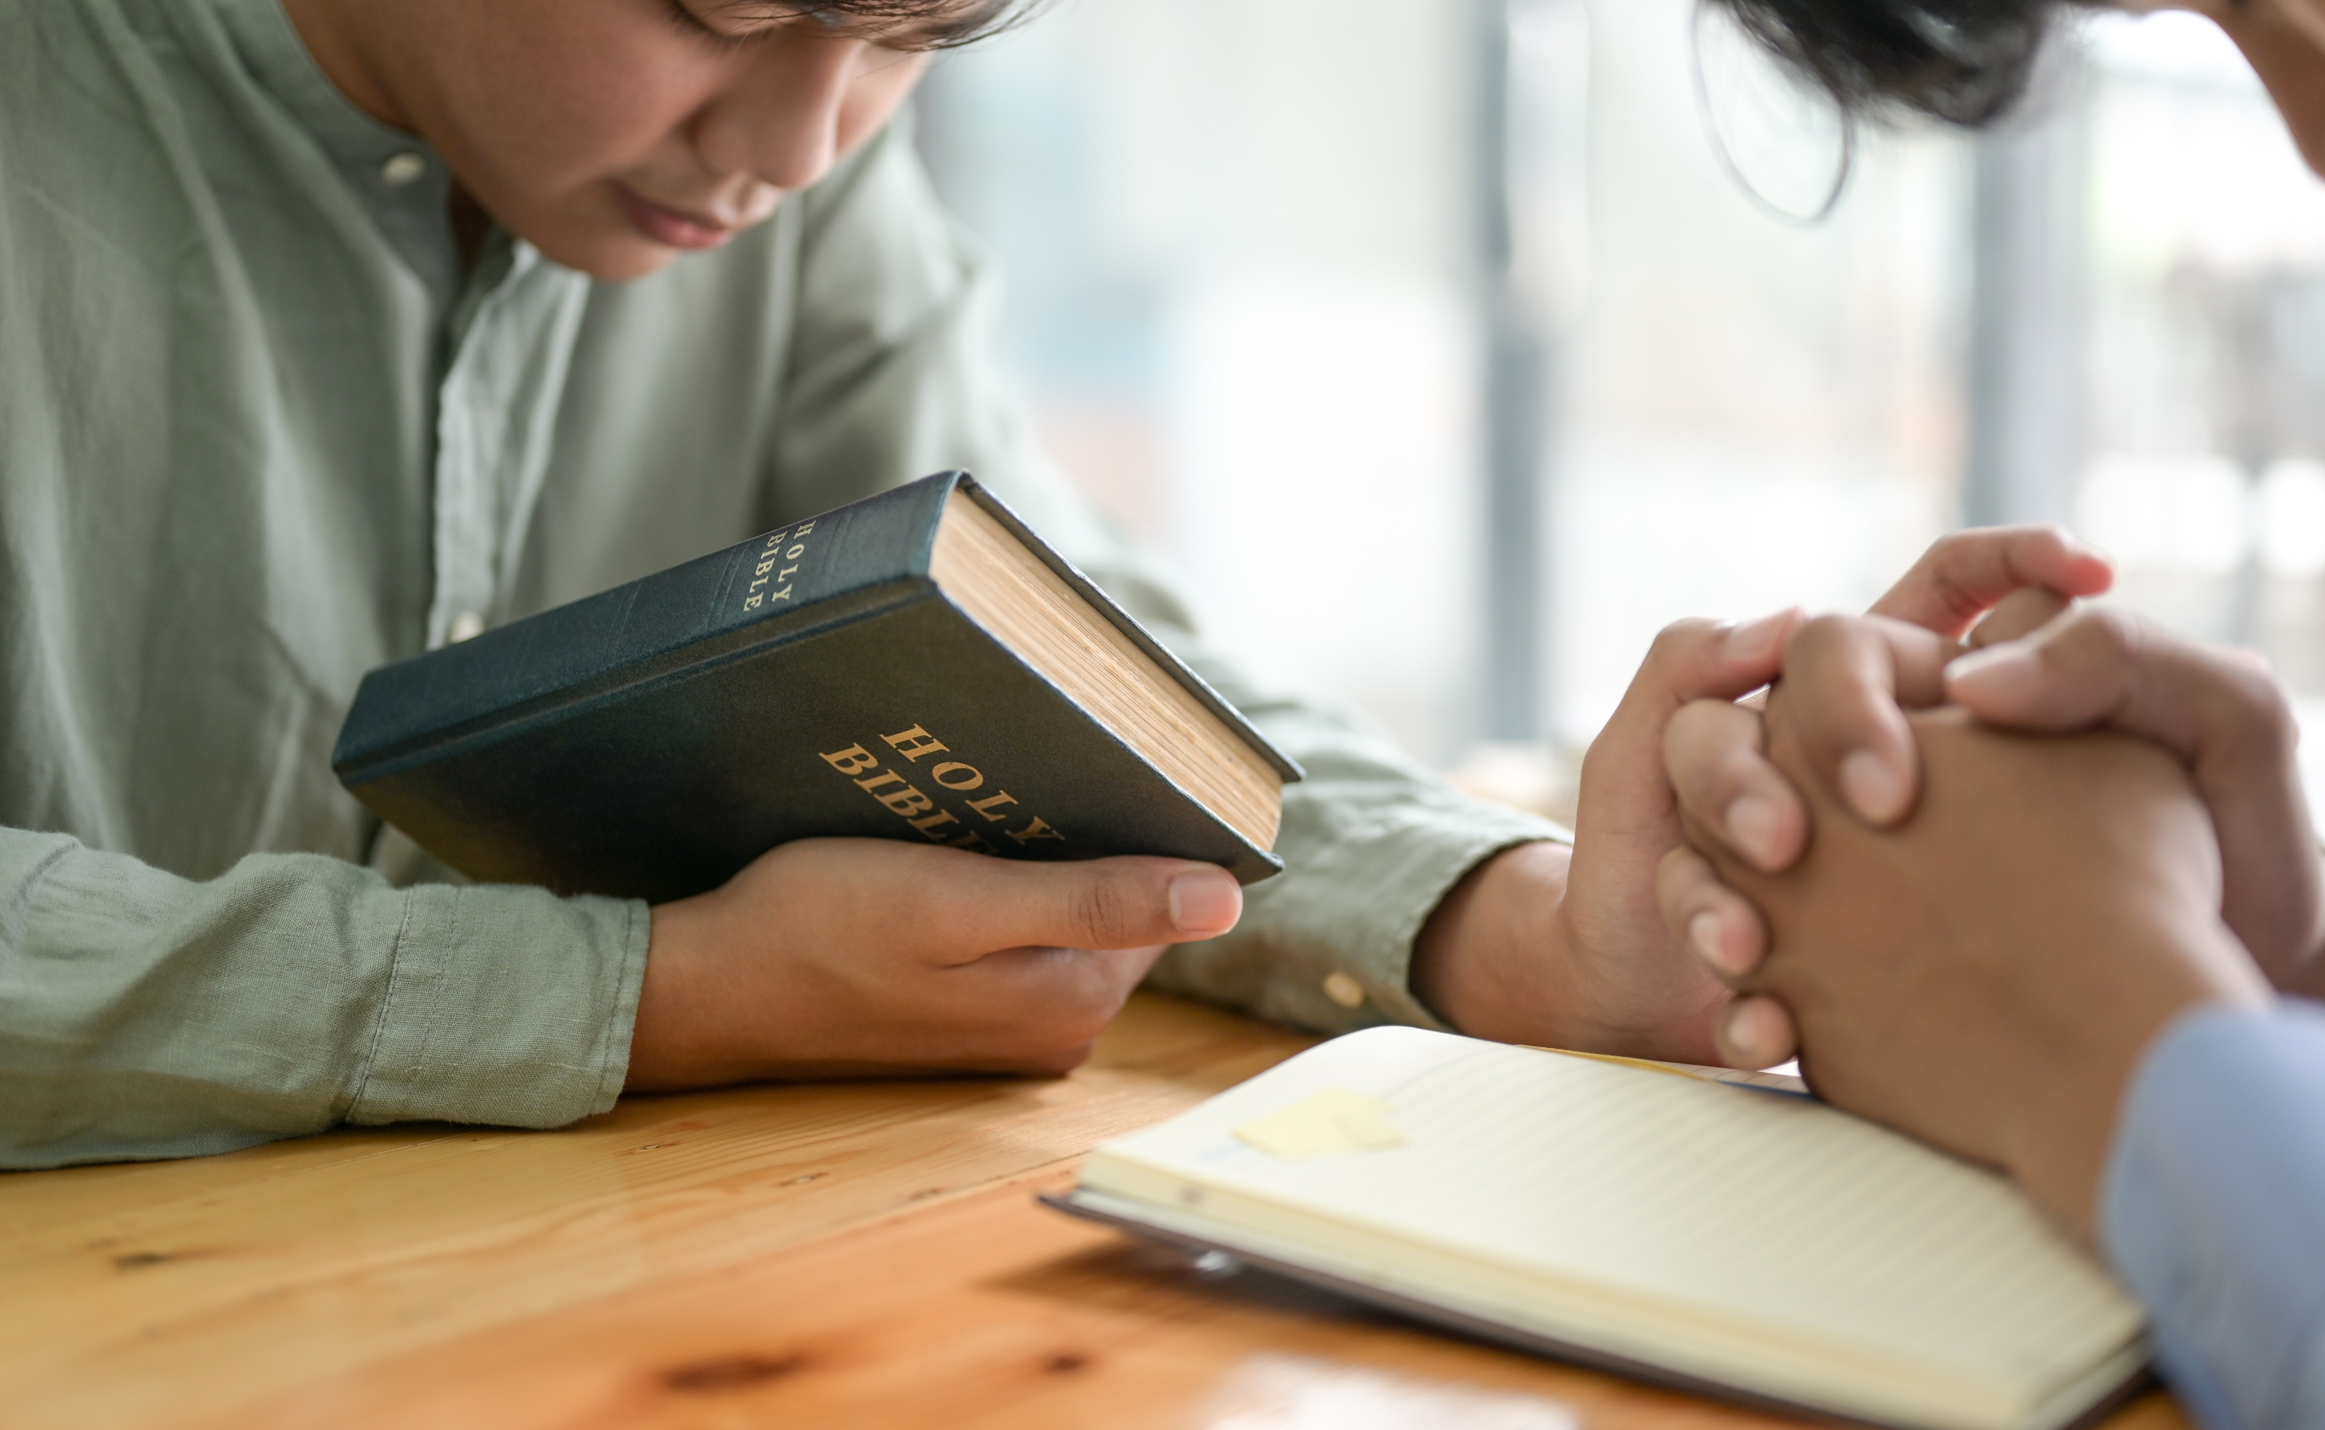
Prayerwalking helps us agree in Prayer
When intercessors pray in agreement, they aren’t generating power by some mathematical formula.
“For where two or three have gathered together in My name, there I am in their midst.” When Jesus is in the midst of agreeing pray-ers, we can be sure that the Father is doing His work by his power-because of Jesus.
Somehow walking together evens the field so that longstanding lay/clergy splintering almost disappears. Those who may not feel eloquent can still join in the prayer fully by silently walking, using their faith with every step.
When walking a street together, prayerwalkers are surrounded by prayer needs, and it becomes easier to share the same concerns and the same level of intensity.
Notes:
When intercessors pray in agreement, they aren’t generating power by some mathematical formula.
“For where two or three have gathered together in My name, there I am in their midst.” When Jesus is in the midst of agreeing pray-ers, we can be sure that the Father is doing His work by his power-because of Jesus.
Somehow walking together evens the field so that longstanding lay/clergy splintering almost disappears. Those who may not feel eloquent can still join in the prayer fully by silently walking, using their faith with every step.
When walking a street together, prayerwalkers are surrounded by prayer needs, and it becomes easier to share the same concerns and the same level of intensity

Slide 4
Prayerwalking helps focus your faith
God is never coerced by repeated formulas of words, however loud or eloquent the display of human verbiage. In the same way, God is unmoved by attempts to manipulate Him by physical maneuvers. Our walking does not wake Him up. God instead delights to respond to the requests of people as they extend themselves to Him in sincere faith.
Faith is a personal reliance on God expressed in actions. Faith is simple in that there is but one object of our trust , the person of Jesus Christ.
Prayer in faith is the gathered involvement of your heart, mind, soul and body. Just as prayer becomes more powerful as individuals gather together and agree, so too when every member of your being is gathered and exerted in a singular act of prayer, you will notice a greater vitality.
Faith exerted in prayer can be likened to the dynamic of leverage. Through prayer we lift matters of concern to God with our faith. Prayer walking simply provides a stronger leverage point. When we draw closer to who we are praying for, somehow our little faith can go a long way to lift our requests to God.
Notes:
God is never coerced by repeated formulas of words, however loud or eloquent the display of human verbiage. In the same way, God is unmoved by attempts to manipulate Him by physical maneuvers. Our walking does not wake Him up. God instead delights to respond to the requests of people as they extend themselves to Him in sincere faith.
Faith is a personal reliance on God expressed in actions. Faith is simple in that there is but one object of our trust , the person of Jesus Christ.
Prayer in faith is the gathered involvement of your heart, mind, soul and body. Just as prayer becomes more powerful as individuals gather together and agree, so too when every member of your being is gathered and exerted in a singular act of prayer, you will notice a greater vitality.
Infantry Marches were used because they would mass the firepower. Perhaps prayer walks are the same. They mass the faith power.

Slide 5
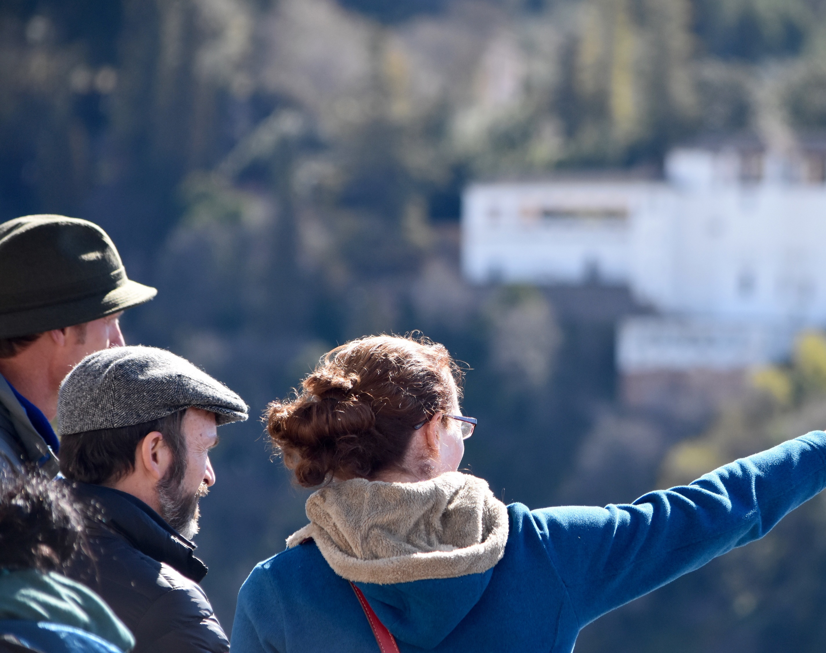
Prayerwalking helps guide your prayers
Walking amidst scenes of unanswered prayer spotlights specific prayer needs. Prayers can be razor sharp for specific families with names and faces. Perception is heightened, and thus prayer can be far more directed by the Spirit of God.
Notes:
“Scenes of unanswered prayer.” You see what only God’s power can deal with and you ask him to deal with it on site.

Slide 6
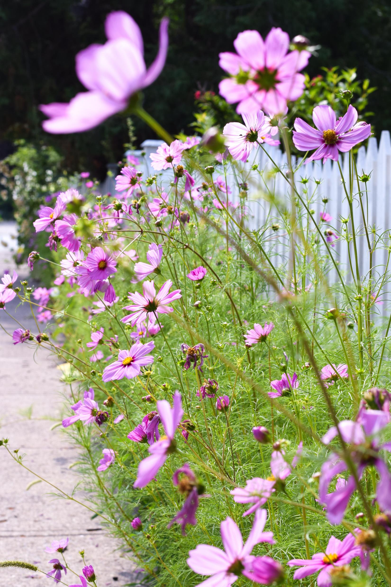
The Triple Dynamic of Fruitful Prayerwalks
We can categorize the effect of prayerwalking by seeing its influence in three directions: before the throne of God, amidst the realm of evil powers and throughout the communities of people.
These three aspects suggest three different dynamics of most fruitful prayerwalks: worship of God, warfare against evil and a welcome to Christ’s kingdom in people’s hearts.
Notes:
Read whole slide

Slide 7
Worship
Some prayer walks emphasize bringing pleasure to God’s heart. Sincere intercessory prayer leans hard on the promises of God and thus invariably proclaims the excellencies of God. Prayer walkers often give themselves entirely to the work of magnifying God, offering him praises from the places they stand. The concern for His pleasure almost eclipses all other concerns.
Notes:
Sometimes its focused on worship and not on prayer. Being led by the Spirit.

Slide 8
Warfare
Many prayerwalks aim to expose, limit or displace the power of evil forces. They seek to bring healing in order to interrupt sinful cycles which feed entrenched evil. Malevolent powers are restrained so that good things may come forth.
Research on the spiritual history of the city helps in many ways when praying for and over a city or area. Inside knowledge can be gained as the spiritual history of an area is researched and revelation is prayed for.
Tree Illustration – Mark Geppert (Pittsburgh PA) pg 41

Slide 9
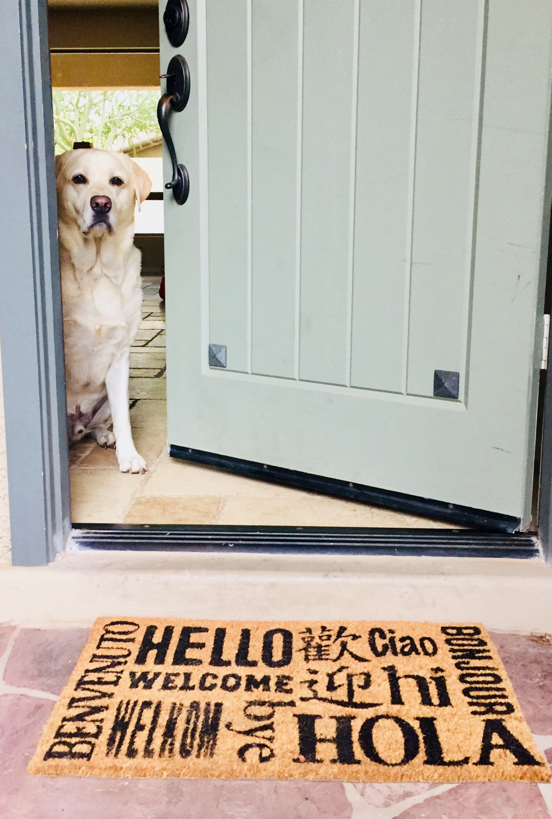
Welcome
At times prayerwalkers pronounce blessings upon the community, sometimes demonstrating their expectation of God’s coming kindness by offering to pray with hurting people. As God brings prayed-for results, people of the community often turn their hearts expectantly toward God, welcoming the further work of Christ in their city. A climate of receptivity increases. People are stirred with a hunger for God, awakened to a gentle yearning for the kingdom of God. The Holy Spirit engenders a welcome for the Son of God.
“Begin by praying blessing over the entire area. Pray for everyone in a global way. Pray for salvation, healing and spiritual freedom over each block, lot, house, office and apartment.” John Huffman (Latin America Mission) “Manual of Participatory Missionary Prayer”

Slide 10
Integrating Worship, Warfare and Welcome
Any healthy prayerwalk will include all three-worship, warfare and welcome. At any given moment one dimension or another may be the dominant dynamic. This is normal, but a wholesome blend is essential.
Prayerwalkers who blend worship, warfare and welcome tend to continue in the vision with less intimidation and more joy. The prayerwalking efforts which have reported dramatic results-many people coming to Christ, churches being planted or withering crime rates-featured each of these three dynamics in some way. However, do not think of these three dynamics as independent ingredients. You can’t fully practice any of of them without in some way doing them all.

