Slide 1
Where Satan Lives
Revelation 2:12-17
Notes:
The Compromising Church
¹² “And to the ^{[a]}angel of the church in Pergamos write,
‘These things says He who has the sharp two-edged sword: ¹³ “I know your works, and where you dwell, where Satan’s throne is. And you hold fast to My name, and did not deny My faith even in the days in which Antipas was My faithful martyr, who was killed among you, where Satan dwells. ¹⁴ But I have a few things against you, because you have there those who hold the doctrine of Balaam, who taught Balak to put a stumbling block before the children of Israel, to eat things sacrificed to idols, and to commit sexual immorality. ¹⁵ Thus you also have those who hold the doctrine of the Nicolaitans, ^{[b]}which thing I hate. ¹⁶ Repent, or else I will come to you quickly and will fight against them with the sword of My mouth.
¹⁷ “He who has an ear, let him hear what the Spirit says to the churches. To him who overcomes I will give some of the hidden manna to eat. And I will give him a white stone, and on the stone a new name written which no one knows except him who receives it.” ’

Slide 2
The Compromising Church Revelation 2:12-17
^{Revelation 2:12} “And to the ^{[a]}angel of the church in Pergamos write,
‘These things says He who has the sharp two-edged sword: ¹³ “I know your works, and where you dwell, where Satan’s throne is. And you hold fast to My name, and did not deny My faith even in the days in which Antipas was My faithful martyr, who was killed among you, where Satan dwells. ¹⁴ But I have a few things against you, because you have there those who hold the doctrine of Balaam, who taught Balak to put a stumbling block before the children of Israel, to eat things sacrificed to idols, and to commit sexual immorality. ¹⁵ Thus you also have those who hold the doctrine of the Nicolaitans, ^{[b]}which thing I hate. ¹⁶ Repent, or else I will come to you quickly and will fight against them with the sword of My mouth.
¹⁷ “He who has an ear, let him hear what the Spirit says to the churches. To him who overcomes I will give some of the hidden manna to eat. And I will give him a white stone, and on the stone a new name written which no one knows except him who receives it.” ’

Slide 3
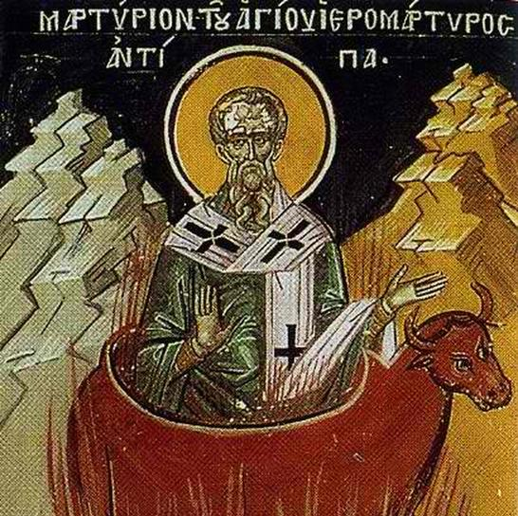
Antipas
Mentioned only in Revelation 2
He was described as a martyr for his faith and “Faithful Witness”
Ministered where Satan had his seat
Died in the temple of Apollos in what is now in the vicinity of Geneva Switzerland.
Notes:
In the Bible, the man named Antipas is mentioned only in the Book of Revelation 2, Verse 13, and is described as a martyr for the Christian faith; described as a "faithful witness" of Christ Jesus; and described as dwelling and ministering where Satan had his seat (Pergamos). Antipas was a contemporary of the Apostle John, who penned The Book Of Revelation. While Antipas was martyred late in the lifetime of the Apostle John, precious little else is factually known about Antipas from respected historical sources. However, traditions originating within the Eastern Orthodox Christian church, around and after CE 1,000, paint a fuller picture only if one can believe them as factual. The traditional (possibly fictional) Antipas was reputed to be the Bishop of the Christian church at Pergamos, and that he was martyred for his faith because of his consistent faithful witnessing in the face of all the satanic evil present there. When Antipas was advised: "Antipas, the whole world is against you!", Antipas reputedly replied: "Then I am against the whole world!" Antipas was supposedly roasted alive in a hollow life-size bull, which had a bonfire under its belly, because Antipas refused to renounce his faith in Christ Jesus. This Much Is Known For Sure: His faithful witnessing and eventual martyrdom for his unshakable faith in Christ Jesus are what earned Antipas mention in the pages of Holy Scripture, and a place in God's "Hall-Of-Fame Of Faith".

Slide 4
Where did Antipas Minister?
Antipas ministered “where Satan has his seat.” (Pergamos)
According to Revelations 2

Slide 5
Satan’s Seat
Notes:
The famous altar of Zeus, which was originally in the Acropolis, was taken to Germany in 1897and is presently on exhibition at the Pergamon museum in Berlin. The five-step foundations of the Altar of Zeus are still in place at the Acropolis of Pergamum.

Slide 7
Where was Antipas martyred?
The traditional account goes on to say Antipas was martyred during the reign of Nero (54-68), by burning in a brazen bull-shaped altar at the Appollyon temple in Lyon/ Geneva Switzerland.

Slide 8
Notes:
A Brazen Bull similar to in which Antipas was martyrd

Slide 9
Notes:
The Bull of Wall Street – Wall Street (Lower Manhatttan New York)

Slide 10
Notes:
Cern Comples

Slide 11
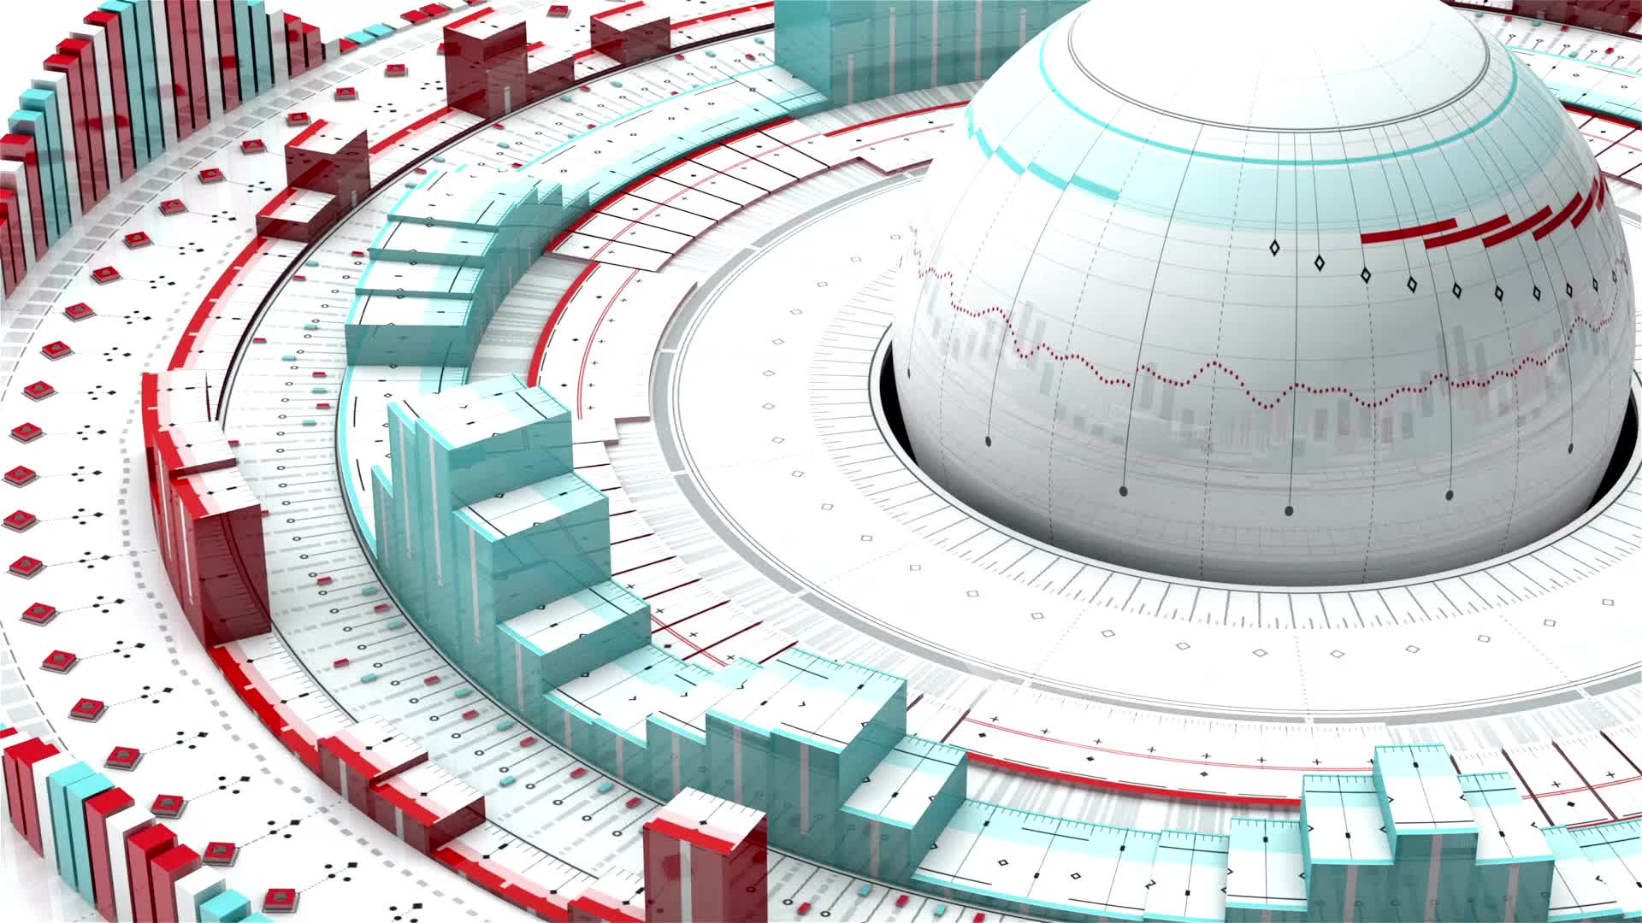
What Happens at CERN?
CERN's main function is to provide the particle accelerators and other infrastructure needed for high-energy physics research — consequently, numerous experiments have been constructed at CERN through international collaborations. CERN is the site of the Large Hadron Collider (LHC), the world's largest and highest-energy particle collider.

Slide 12
Saint-Genus-Poilly
Now on top of all the speculation as to what CERN scientists are really attempting to do with their Large Hadron Collider, many observers could not help but notice that the town in France where CERN is partially situated is called “Saint-Genus-Poilly.” The name Pouilly comes from the Latin “Appolliacum” and it is believed that in Roman times a temple existed in honor of Apollo, and the people who lived there believed that it is a gateway to the underworld. It is interesting to note that CERN is built on the same spot.
Religious leaders – always suspicious of the aims of the scientific world - drew a connection to a verse straight out of Revelations (9:1-2, 11), which makes reference to the name ‘Apollyon.’ The verse states: “To him was given the key of the bottomless pit. And he opened the bottomless pit… And they had a kind over them, which is the angel of the bottomless pit, whose name in the Hebrew tongue is Abaddon, but in the Greek tongue hath his name Apollyo

Slide 13
Abbaddon/Appollyon from Got Questions.org
The name Abaddon or Apollyon appears in Revelation 9:11: “They had as king over them the angel of the Abyss, whose name in Hebrew is Abaddon, and in Greek, Apollyon.” In Hebrew, the name “Abaddon” means “place of destruction”; the Greek title “Apollyon” literally means “The Destroyer.” In Revelation 8–9, John describes a period during the end times when angels sound seven trumpets. Each trumpet signals the coming of a new judgment on the people of earth. When the fifth angel blows his trumpet, the Abyss, a great smoking pit, will open, and a horde of demonic “locusts” will rise out of it (Revelation 9:1-3). These creatures will be given the power to torture any person who does not bear God’s seal (verse 4). The pain they inflict will be so intense that sufferers will wish to die (verse 6). Abaddon/Apollyon is the ruler of the Abyss and the king of these demonic locusts. Abaddon/Apollyon is often used as another name for Satan. However, Scripture seems to distinguish the two. We find Satan later on in Revelation, when he is imprisoned for 1,000 years (Revelation 20:1-3). He is then released to wreak havoc on the earth (verses 1-8) and ultimately receives his final, eternal punishment (verse 10). Abaddon/Apollyon is likely one of Satan’s underlings, a destroying demon and one of the “rulers,” “authorities,” and “powers” mentioned in Ephesians 6:12.
Notes:
Fifth Trumpet: The Locusts from the Bottomless Pit
9 Then the fifth angel sounded: And I saw a star fallen from heaven to the earth. To him was given the key to the ^{[a]}bottomless pit. ² And he opened the bottomless pit, and smoke arose out of the pit like the smoke of a great furnace. So the sun and the air were darkened because of the smoke of the pit. ³ Then out of the smoke locusts came upon the earth. And to them was given power, as the scorpions of the earth have power. ⁴ They were commanded not to harm the grass of the earth, or any green thing, or any tree, but only those men who do not have the seal of God on their foreheads. ⁵ And ^{[b]}they were not given authority to kill them, but to torment them for five months. Their torment was like the torment of a scorpion when it strikes a man. ⁶ In those days men will seek death and will not find it; they will desire to die, and death will flee from them.
⁷ The shape of the locusts was like horses prepared for battle. On their heads were crowns of something like gold, and their faces were like the faces of men. ⁸ They had hair like women’s hair, and their teeth were like lions’ teeth. ⁹ And they had breastplates like breastplates of iron, and the sound of their wings was like the sound of chariots with many horses running into battle. ¹⁰ They had tails like scorpions, and there were stings in their tails. Their power was to hurt men five months. ¹¹ And they had as king over them the angel of the bottomless pit, whose name in Hebrew is ^{[c]}Abaddon, but in Greek he has the name ^{[d]}Apollyon.

Slide 15
Shiva – Hindu Goddess of Destruction
Notes:
Suspicions persist, however. CERN recently found it prudent to answer a question about why it has a statue of the Hindu god Shiva, a complex deity sometimes characterized as “The Destroyer,” on the premises. CERN answers that the Shiva statue was a gift from the Indian government, India being one of CERN’s observer states along with Russia, Japan and the US. CERN emphasizes that it is a multicultural institution, with scientists from more than 100 countries — presumably of various religious beliefs. The Shiva statue is not the only artwork on the premises, CERN is also careful to say. CERN draws attention not to Shiva’s reputation as a destroyer but as a symbol of Shakti — or “life force.”

